Slide 1

TIME SERIES FORECASTING USING HOLT WINTERS IN R PROGRAMMING
Dataset consists of 48 rows and 2 columns namely ‘month’ and ‘sales’ and covers the period from 1st Jan’13 to 31st Dec’16
Objective: To forecast sales for the company
Data Cleaning: Formatted the ‘month’ column by using “lubridate” package and converted it to a date vector from character vector. There was no missing data

Slide 2
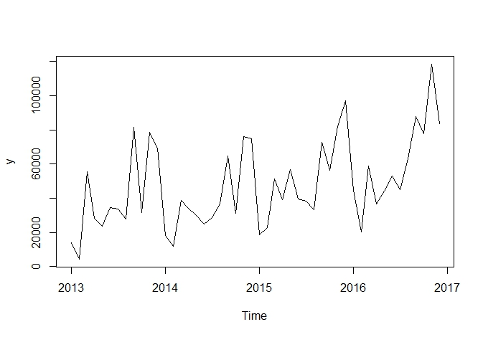
CONVERSION TO TIME SERIES
We use the ‘ts’ function to convert the ‘sales’ data into a Time Series object. Frequency will be set to 12 as it is a monthly data
We plot the time series and we find that there is a clear seasonal pattern with higher sales being recorded in November and December followed by a fall in January. This is also visible with a jump in sales in March as compared to Feb.

Slide 3
HOLT WINTERS METHOD
We will split the data into training and test data using the ‘window’ function.
Training data will contain sales data from Jan,2013 to Feb,2016 and test data will contain sales data from Mar’2016 to Dec’2016
Looking at the time series plot, we can make an assumption for additive model where the changes in sales do not seem to be exponential
We forecast the sales data from Mar’2016 to Feb’2017 using the ‘forecast’ function and plot the same

Slide 4
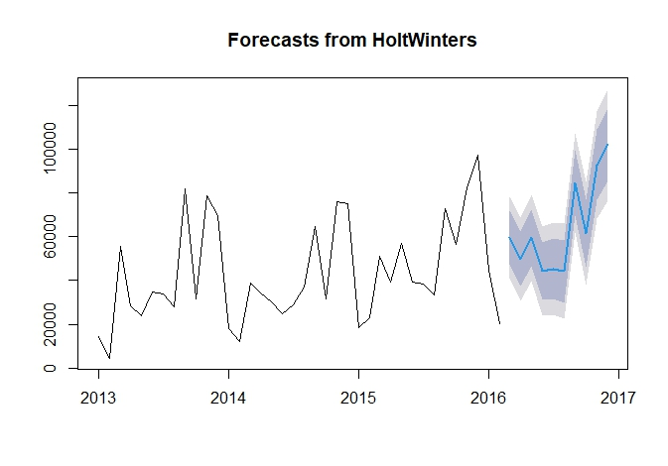
FORECASTING PLOT

Slide 5
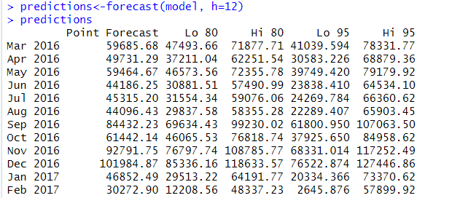
CONCLUSION
The blue line in the forecasting plot indicates the predicted sales value with the darker grey shade indicating the sales value at lower and upper levels of 80% prediction level and lighter grey shade indicating the sales value at lower and upper levels of 95% prediction level
RMSE is 14532.99 and MAPE is 18.69 (accuracy is 81.31%)
Here we try to forecast the sales without any external regressors (like advertising budget, holidays etc) and used only historical data to forecast the sales

